Slide 1
Interreg IPA
Romania-Serbia Programme
Cooperation beyond borders!
Timisoara, Romania
Programme co-funded by the European Union

Slide 2
Common rules apply to all project partners.
The Visual Identity Manual (VIM) and models of various communication tools will be available on:
www.romania-serbia.net
Project partners have to promote the results and benefits of their projects to relevant groups or to the general public, using plain language and the Programme logo.

Slide 3
Objectives of visibility and communication:
support the successful implementation of the project;
increase public awareness about the project and its results;
ensure transparency in the use of funds;
highlight the role of the European Union.

Slide 4
Requirement:
The Lead Partner shall ensure that:
communication and visibility materials realized by the project are made available upon request to programme bodies, European Union institutions, bodies, offices or agencies
and that a royalty-free, non-exclusive and irrevocable license to use such material and any pre-existing rights attached to it is granted to the European Union.
(CPR Regulation 2021/1060 Annex IX point 2)

Slide 5
Communicator
Information and publicity measures
A person responsible at the project level
Mandatory use for all projects
Inform JS on the measures taken to promote your project
Durable plaques or billboards
The Programme logo
mandatory use on all communication materials

Slide 6
Programme name used for communication purposes:
Interreg IPA Romania-Serbia Programme
Programul Interreg IPA România-Serbia
Interreg IPA Program Rumuniјa-Srbiјa
Интерег ИПА Програм Румунија-Србија

Slide 7
Programme logo
The Programme logo must be used on
all communication materials, preferably the colour version on white background.

Slide 8
Language variations
English
Romanian
Serbian Cyrillic
Serbian Latin

Slide 9
Priority Icons
Priority 1: Environmental protection and risk management
Priority 2: Social and economic development

Slide 10
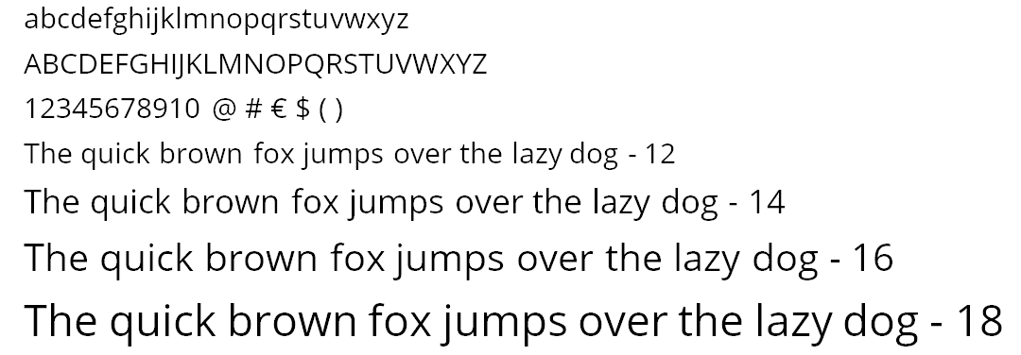
Typography / Fonts
Open Sans is the recommended font.
Contains all styles: regular, bold and italic.
As an alternative to Open Sans: Vollkorn.
Avoid unusual or bizarre fonts, unless the target audience fits with your choice.

Slide 11
Social media
Primary hashtags:
#InterregIPA
#Interreg
#RomaniaSerbia
#InterregIPARomaniaSerbia
#EuropeanUnion
# Project JEMS Code
For the Programme Facebook page use @ipacbcrose to link to the Programme.
For the Programme Twitter page:
@IPACBCRORS.
For the Programme Instagram page:
@ipacbcrors.

Slide 12
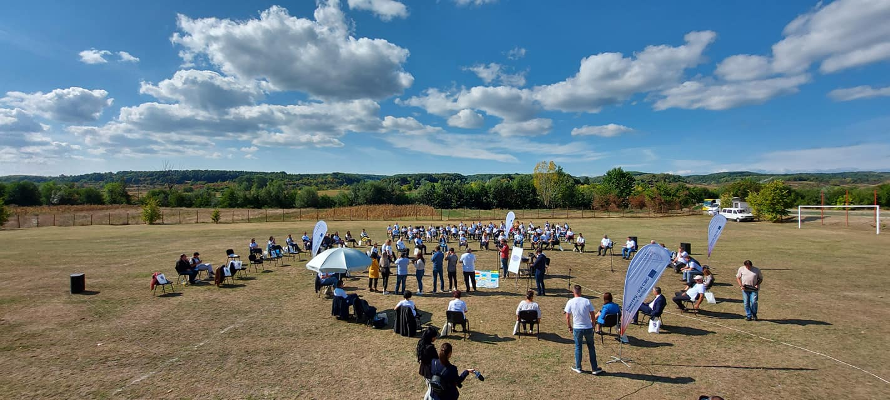
Use photos and mention the copyright holder!
©ROCBC Timisoara

Slide 13
Websites
Each partner shall provide on the partner’s official website or social media sites, where such sites exist,
a short description of the project, including its aims and results.
Good practice: display the Programme logo inside the viewing area of digital devices, without requiring the user to scroll down the page.

Slide 14
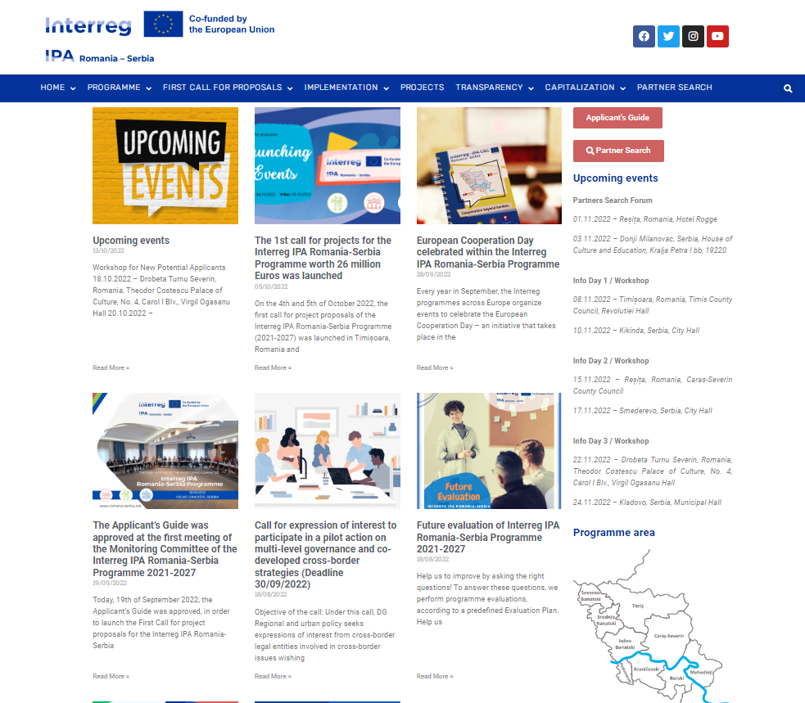
www.romania-serbia.net
Include a link to the Programme website:
Communication materials:
Your own website:
Your social media accounts:

Slide 15
Durable plaques and billboards
Displayed as soon as the physical implementation of operations involving physical investment starts or purchased equipment is installed.
Durable plaques or billboards
Clearly visible to the public;
Include the Programme logo.

Slide 16
Promotional items
In producing promotional items, take a minute to consider their impact environmentally, socially and economically:
Prefer items that are needed and have a high use value.
Prefer local products and production sites closer.
Prefer durable, environmentally friendly materials.
Preferable reusable items and designs;
* On banners avoid dates and stay general.

Slide 17
Incorporate sustainability into your projects
Go greener!
Publications disseminated by electronic means;
Recycled paper, print both sides, print-friendly
The use of natural light is preferred;
The use of energy-efficient light bulbs is strongly encouraged;
Online meetings should be preferred whenever feasible;
Electronic communication should be used instead of printed materials for pre-meeting and follow-up communications;
The use of decorative elements should be minimised;
Reuse of badges should be encouraged.

Slide 18
For advice on visibility contact
the Joint Secretariat
Thank you for your attention!
Dani Bàrdos – Communication Consultant
dani.bardos@brct-timisoara.ro
Regional Office for Cross-border Cooperation Timisoara
+40356426360

